Slide 1
Optimizing Serverless Computing: Introducing an Adaptive Function Placement Algorithm
Nima Mahmoudi and Changyuan Lin
University of Alberta
Hamzeh Khazaei and Marin Litoiu
York University

Slide 2
TOC
Introduction
Experimental Evaluation
Background
Result
Container Placement
Limitations and Future Work
Proposed Method
Conclusion

Slide 3
Introduction

Slide 4
Containerization
Cloud applications are packaged or deployed using VMs or Containers
Containerization has experienced an increase in popularity
Reduced complexity in deploying tiny services
Straightforward scaling, removing, and deployment
Flexibility in leveraging different tools and frameworks
Increased effectiveness of scalability
Improved systems resiliency

Slide 5
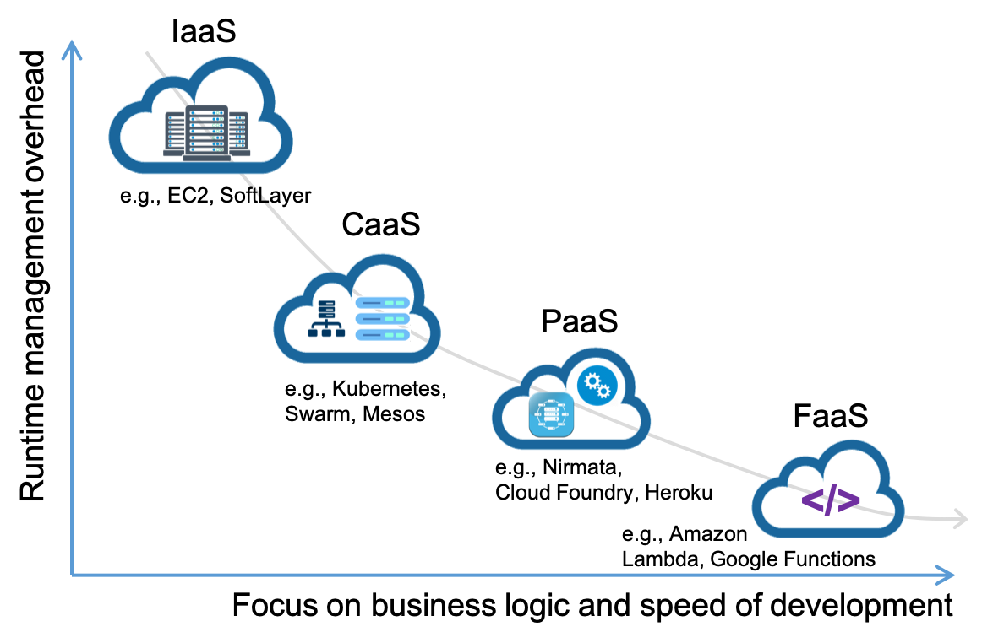
Evolution in Cloud Computing: Going from IaaS to CaaS, PaaS, and FaaS.

Slide 6
Serverless Computing
Runtime operation and management done by the provider
Reduces the overhead for the software owner
Provisioning
Scaling resources
Software is developed by writing functions
Well-defined interface
Functions deployed separately

Slide 7
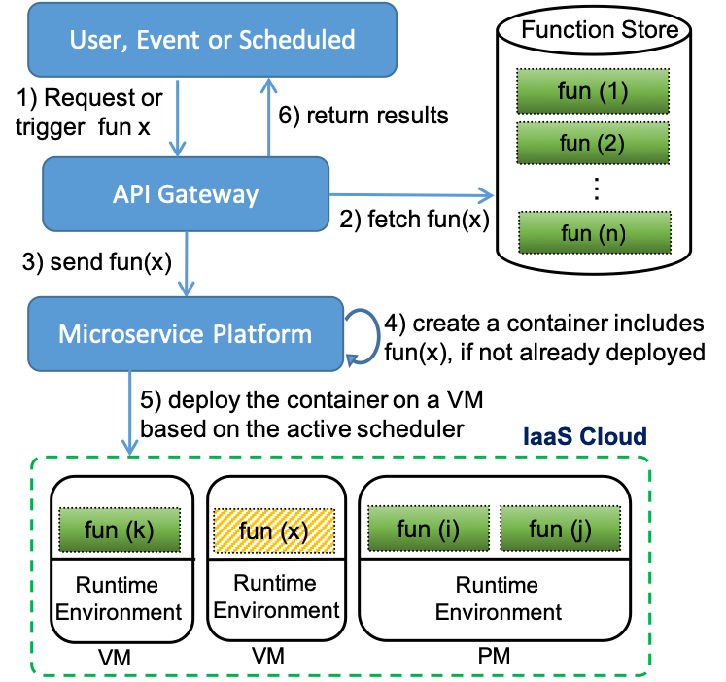
Structure of an example FaaS platform.

Slide 8

Example: A cheque depositing application

Slide 9
Serverless Challenges For The Provider
Ability to deliver on performance
Understanding the resource management
CPU, RAM, or I/O Intensive
Security isolation of functions
DDoS resistance

Slide 10
Container Placement Algorithm
(Scheduler)

Slide 11
Container Placement Algorithms
Which VM should we deploy on?
Deploying a new function
Horizontally scaling an existing container
Current well-known algorithms:
Random: choose randomly
Binpack: Assign to one VM until it is full before assigning them to another one
Spread: Distribute workloads evenly among VMs

Slide 12
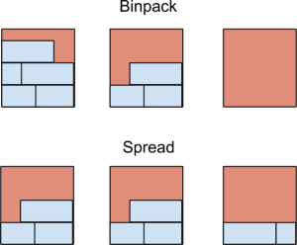
Binpack vs Spread
Source: https://blog.container-solutions.com/using-binpack-with-docker-swarm

Slide 13
Binpack vs Spread
Binpack:
Tries to achieve lower cost
VM with lowest available resources
On average, should achieve lowest possible performance
No knowledge of the needs of the application
Spread:
Tries to achieve best performance
VM with lowest resource utilization
On average, should achieve highest possible performance
No knowledge of the needs of the application

Slide 14
Proposed Method: Smart Spread Algorithm

Slide 15
Smart Spread Algorithm
Each application has specific needs
CPU, RAM or IO-intensive
VM status has the information for resource congestion
To maximize the performance:
Log resource utilization of a function on a reference machine (workload profiling)
Build a performance model using machine learning
Estimate the performance on each VM
Select the VM that will yield the highest throughput

Slide 16
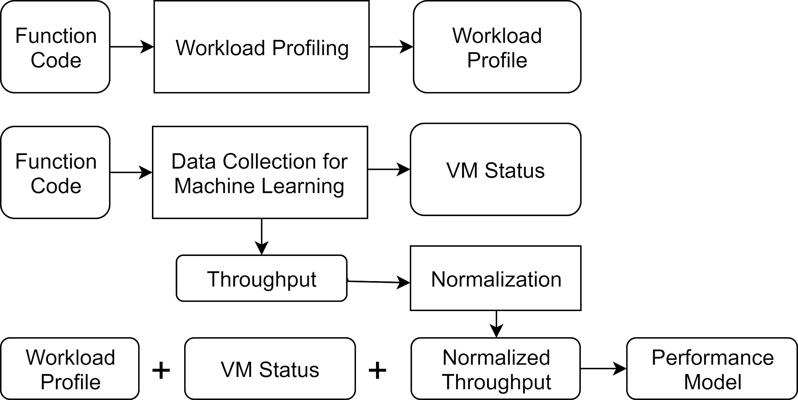
System Overview - Offline Phase

Slide 17
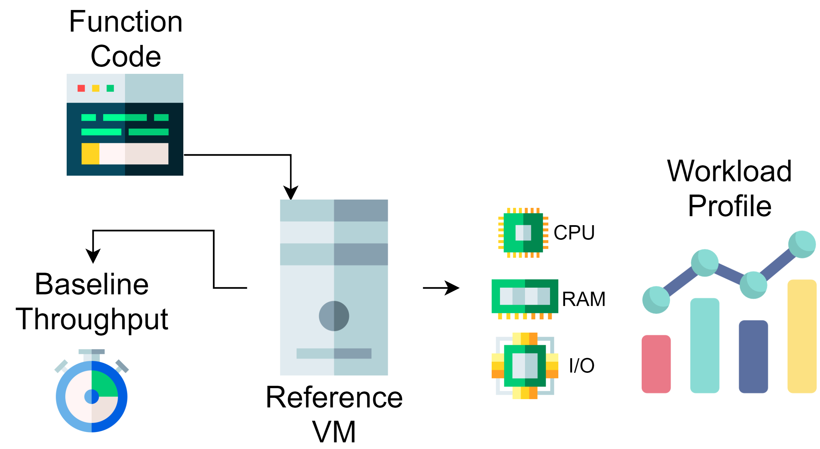
Workload Profiling
Icons made by Freepik from FlatIcon

Slide 18
Workload Profiling
Automatically specify the resource needs of the workload
Interaction between the resource utilization and performance
performance = f(resource utilization, workload characteristics)
Extracted information: resource utilization of the function
Challenge: generalization of knowledge to other workloads

Slide 19
Performance Normalization
Does 10 requests/second mean we have a good performance or bad?
It depends on the workload
Good for image processing
Very low for static file serving
Model should work for all kinds of applications
To be used by the cloud provider
Solution: Measure relative performance compared to the performance on a reference VM

Slide 20
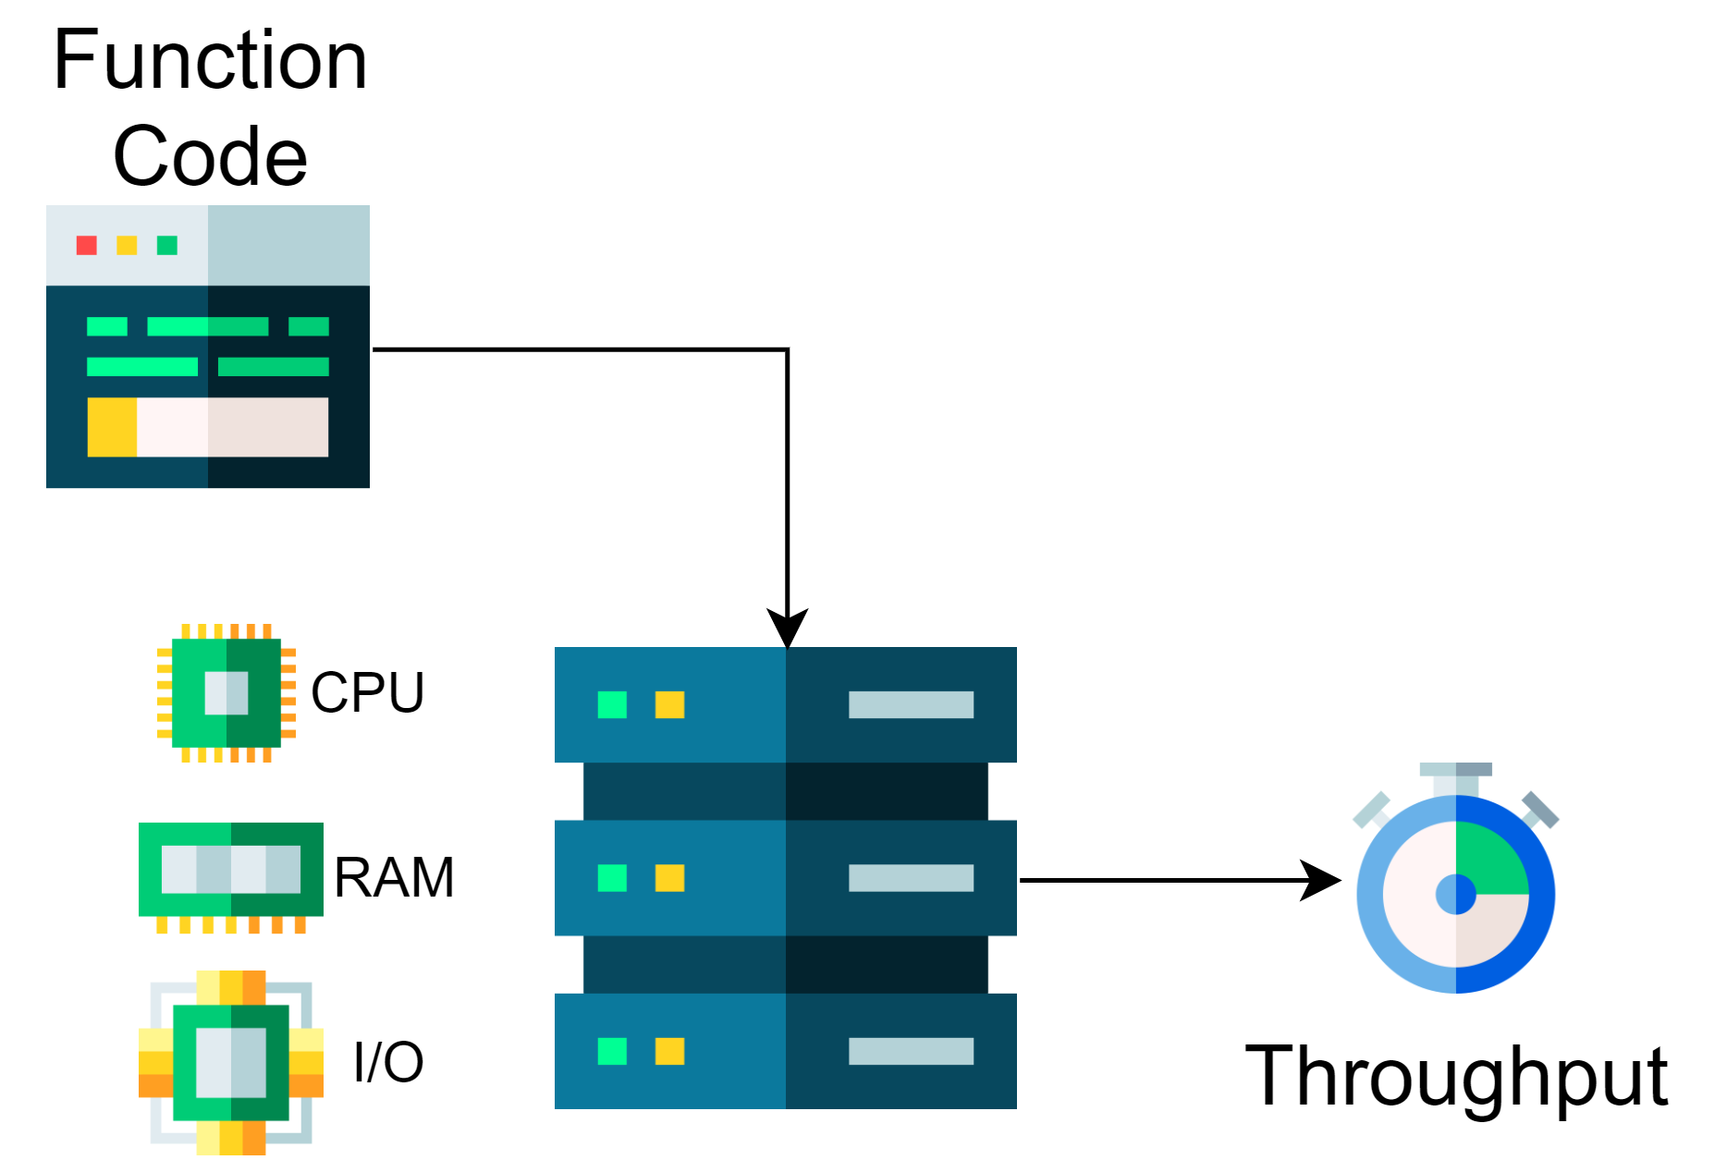
Data Collection for Machine Learning
Icons made by Freepik from FlatIcon

Slide 21
Performance Modeling
Goal: find f such that throughput=f(resource utilization, workload profile)
Method | R² | RMSE | Corr
Linear Regression | 0.8025 | 0.09874 | 0.9104
SVR | 0.9028 | 0.06927 | 0.9540
Decision Tree | 0.9005 | 0.0700 | 0.9537
Random Forest | 0.8990 | 0.0705 | 0.9621
Neural Networks | 0.9289 | 0.0592 | 0.9696

Slide 22
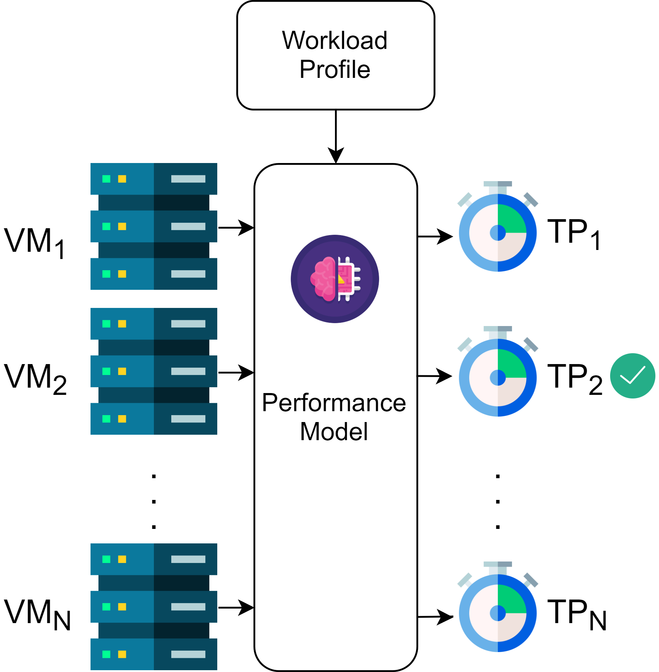
System Overview - Online Phase
Icons made by Freepik from FlatIcon

Slide 23
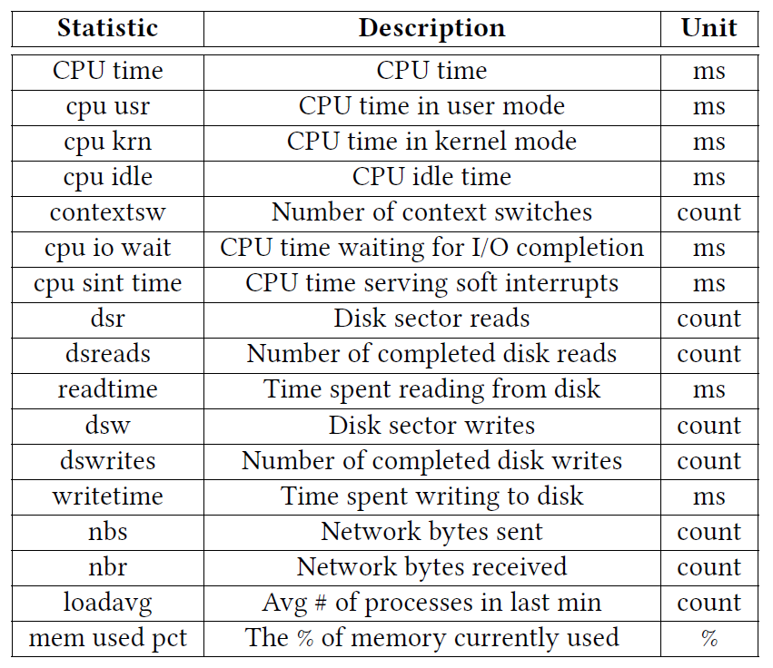
Utilization metrics used for both workload profiling and VM monitoring.

Slide 24
Experimental Evaluation

Slide 25
Cluster Configuration
Property | Value or Include
Number of VMs | 4
vCPU | 2
RAM | 4GB
HDD | 40GB
Network Connection | 1 Gb/s
Operating System | Ubuntu 18.04
Python 3.7 | numpy, scikit, pandas, tensorflow and keras

Slide 26
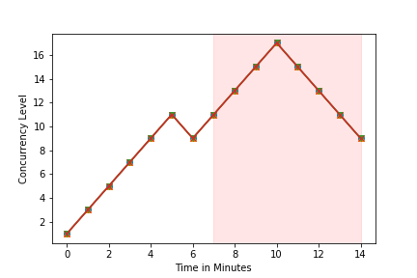
Workloads
App Type | Benchmark | Configuration
CPU Intensive | Sysbench CPU | max-requests=2500 cpu-max-prime=1000
Disk I/O Intensive | Fileio | max-requests=200 file-test-mode=rndrw
Memory Intensive | OLTP | table-size=10000 table-count=3 max-requests=10

Slide 27
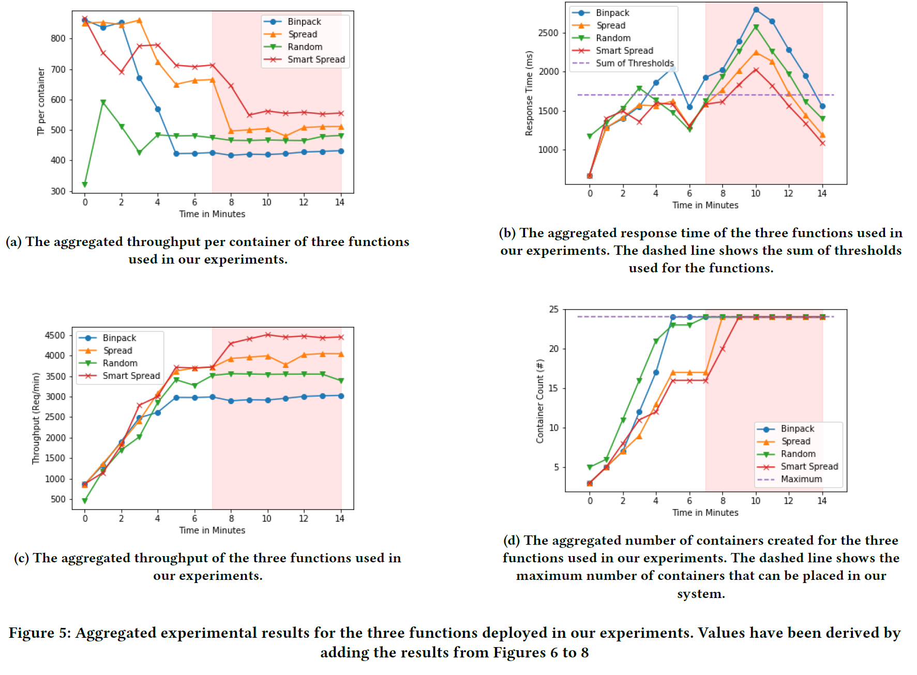
Results

Slide 28
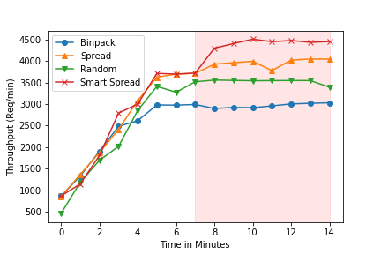
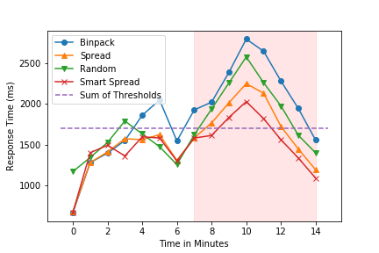
The aggregated throughput and response time in our experiments.

Slide 29
Algorithm | Throughput | Response Time | Rel Thro | Rel RT
Binpack | 2966.38 | 2193.39 | 0.68 | 1.36
Random | 3523.75 | 1954.76 | 0.81 | 1.24
Spread | 3934.62 | 1763.33 | 0.91 | 1.10
Smart Spread | 4341.62 | 1608.49 | 1 | 1
Average aggregated throughput and response time for each placement in heavy load region. Relative throughput (Rel Thro) and relative response time (Rel RT) are relative values to smart spread algorithm results.

Slide 30
Limitations and Future Work
Currently only supports homogeneous clusters
Same configuration and on the same PM
Transfer learning can transport knowledge among different VMs
Doesn’t evolve over time
Update the model over time
Adding new workloads is lengthy and manual
Automate the process with monitoring systems
Deploy on kubernetes-based serverless platforms
Performance isolation techniques for FaaS

Slide 31
Conclusion
Current serverless platforms are oblivious to the type of application being run on them
We presented Smart Spread:
Uses machine learning to predict the performance
Leverages the same performance model for all applications
Captures resource-application interactions
Chooses the VM that maximizes throughput
Experimental results show improved throughput as the result.
Contact Info:
Website: www.nima-dev.com
Twitter: @nima_mahmoudi

